Slide 1

Credit Card Eligibility
Machine learning

Slide 2
Task: The task is to find the important features and their relations. The other task is to predict whether a customer is eligible for credit card or not given the data.
- Rahul AKKINENI

Slide 3
Dataset
The columns in dataset are,
Customer_id: The customer’s identification number.
Demographic_slice: The area under which he comes.
Country_reg: The region of the country he comes from.
Ad_exp: The additional experience of the customer (i.e., if there is any previous impression on customer)
Est_income: The estimated income of the customer.
Hold_bal: Is there any amount on hold on the customer’s present account.
Pref_cust_prob: How much is the customer preferred to be given the card.
Imp_cscore: The credit score of the customer.
Risk_score: How much risk is there in providing the customer with the credit card.
Imp_crediteval: The credit evaluation of the customer.
Axio_score: The probability score of getting the card.
Card_offer: Whether the card is offered to the customer.

Slide 4
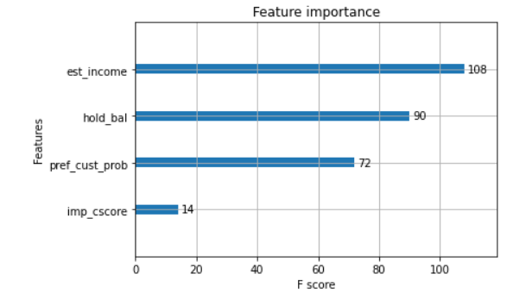
First Task
Feature importance
Graph of feature importance
The important features are est_income, hold_bal and pref_cust_prob.

Slide 5
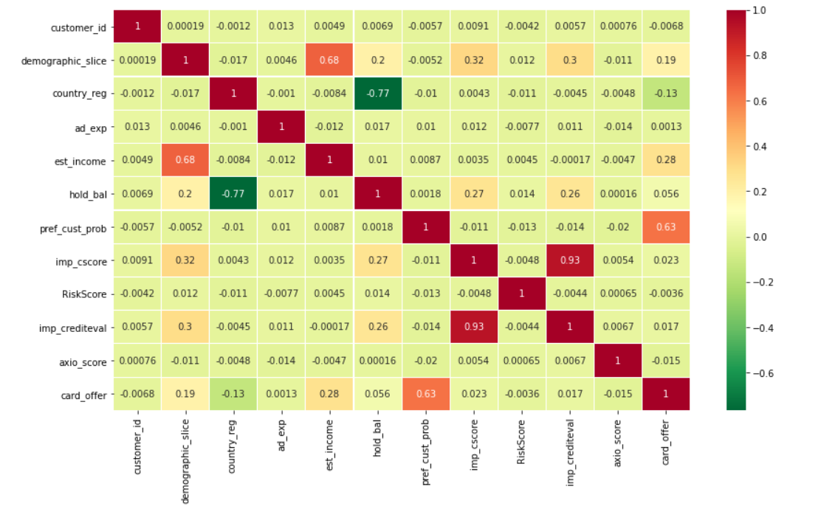
First Task (contd.)
Relationship between features:
Corelation Matrix
The matrix shows how well the relationship is between the different features of the dataset.

Slide 6
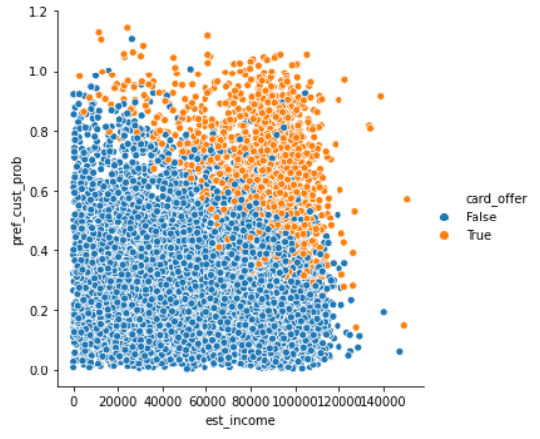
First Task(contd.)
Relationship between features:
Graph between est_income and pref_cust_prob
The data points can be separated by a straight line.
Also, the highest the est_income and pref_cust_prob the higher the chance of getting the card_offer accepted.

Slide 7
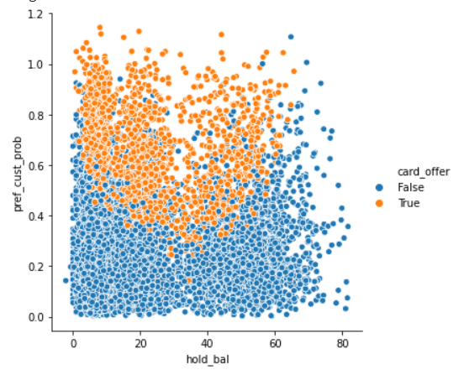
First Task (contd.)
Relationship between features:
Graph between pref_cust_prob
And hold_bal
As you can see the data points formed a parabola shape.
This means the higher the difference between the two features the more there is a chance for the card_offer to be accepted.

Slide 8
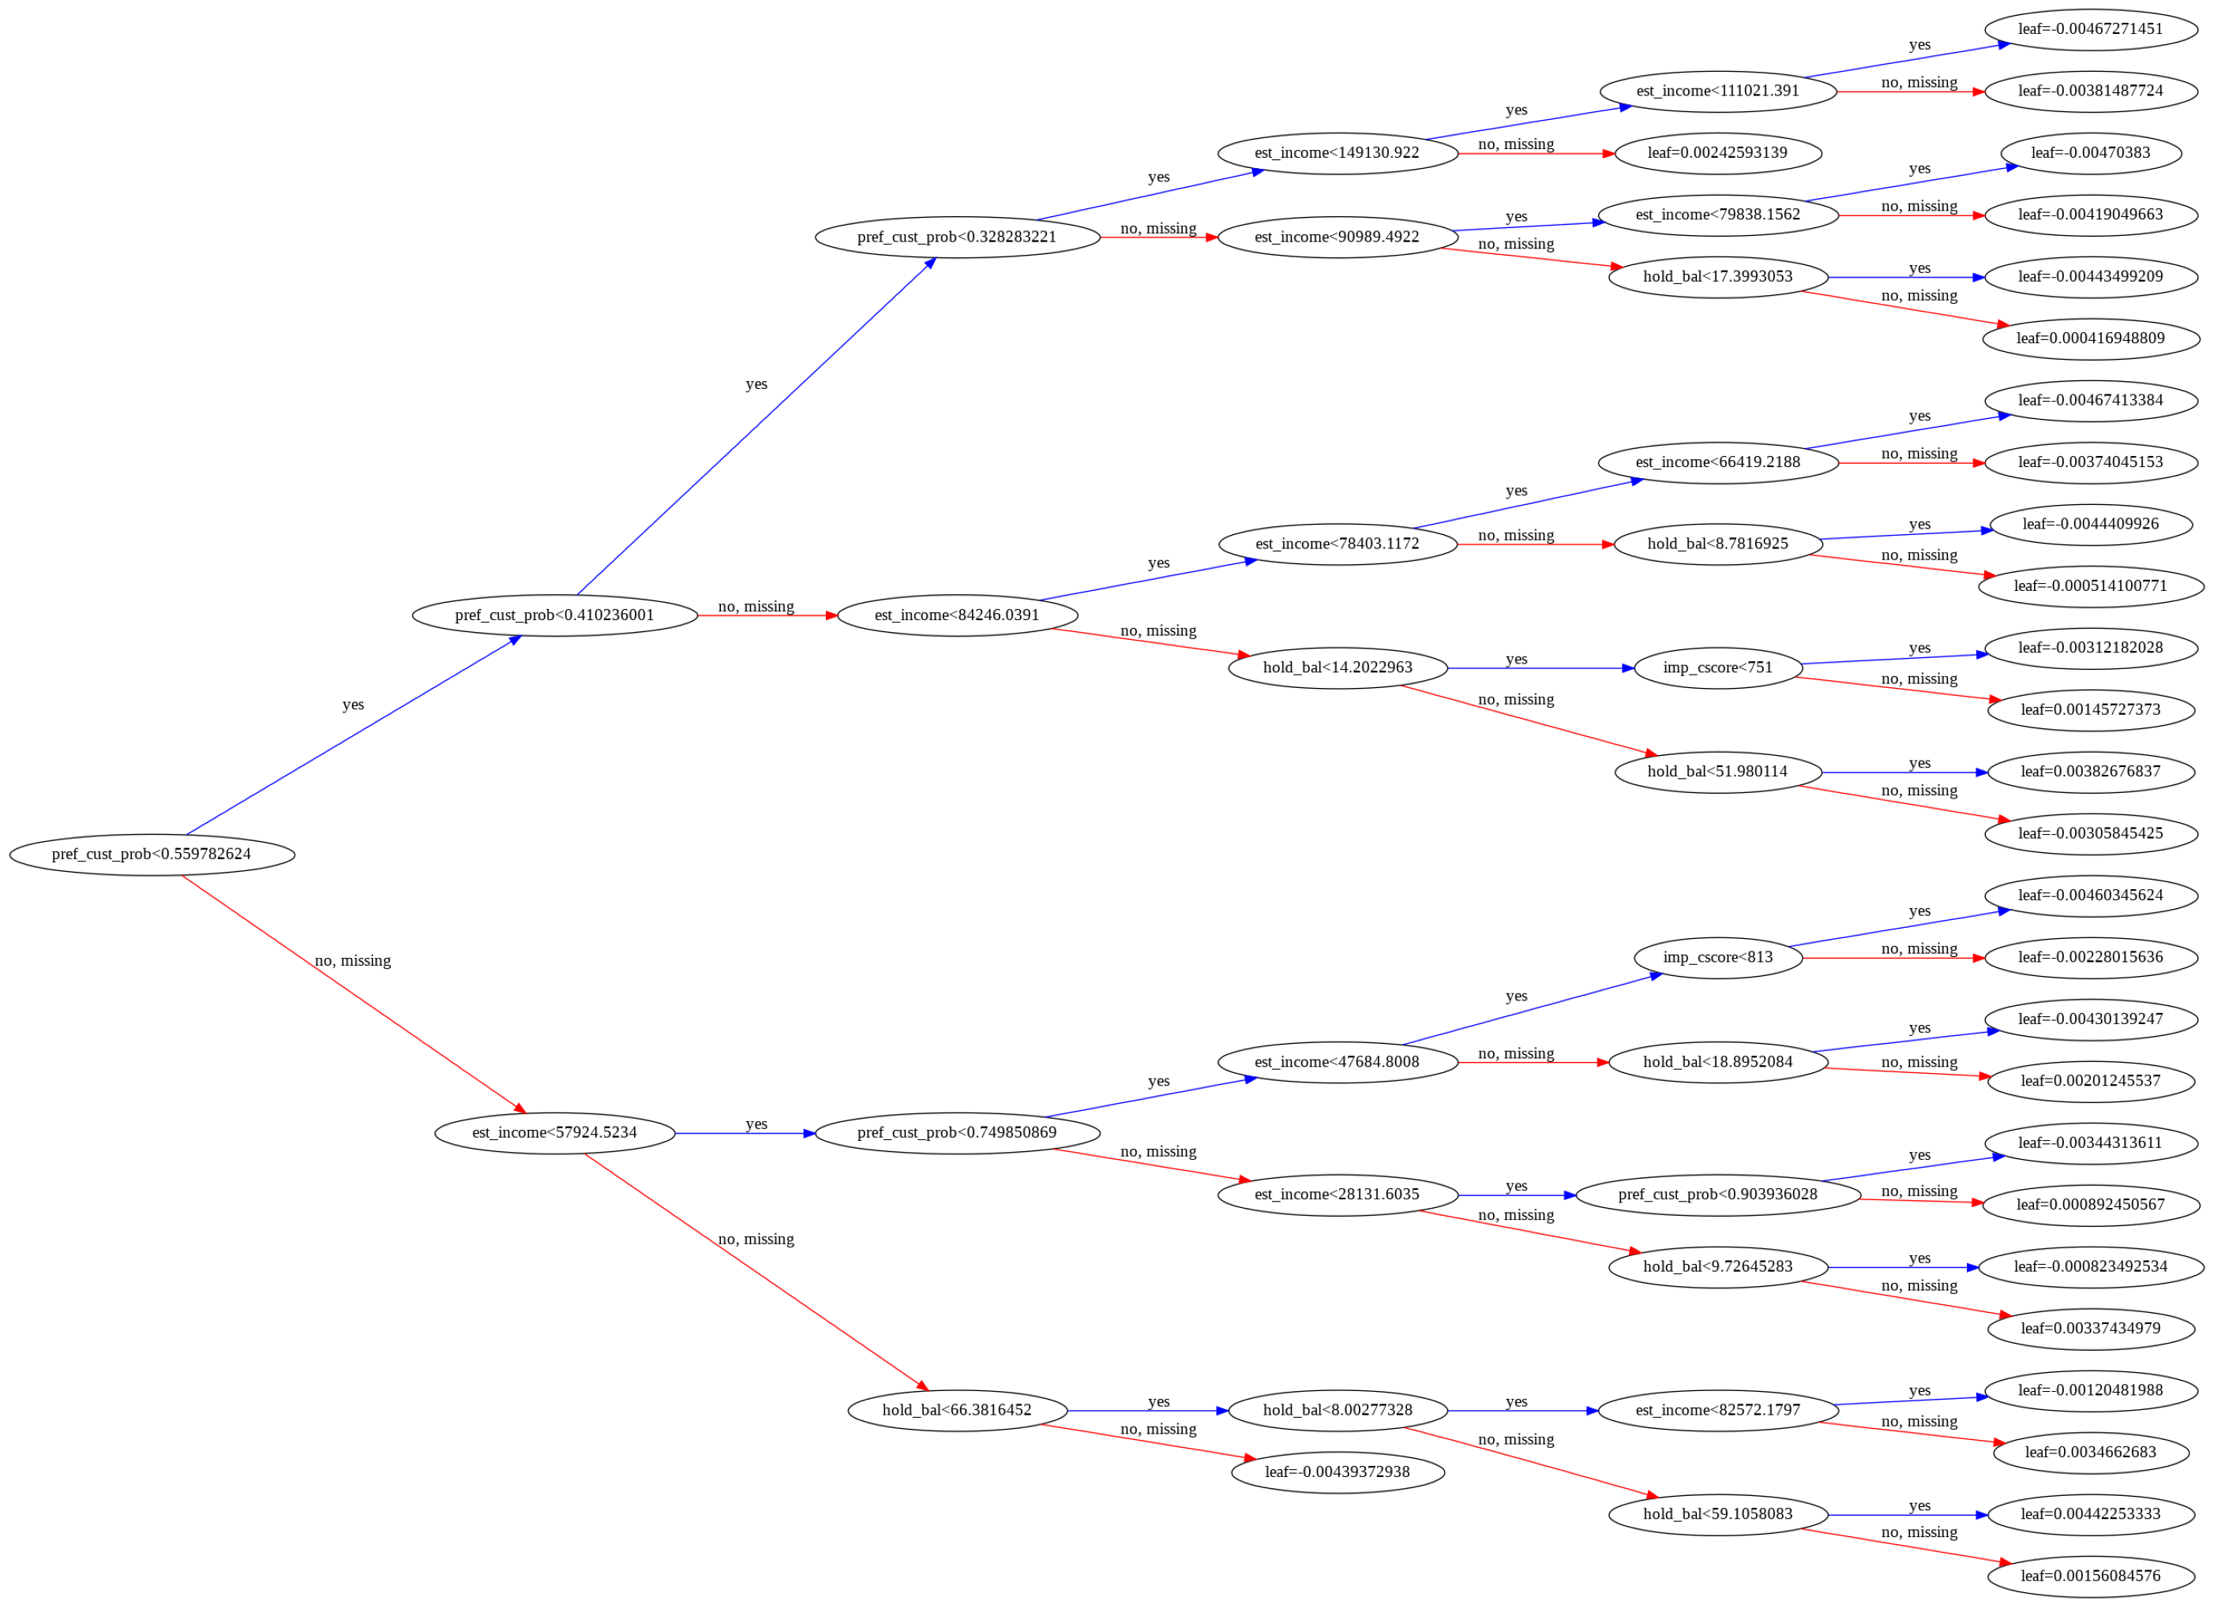
Tree of Prediction

Slide 9
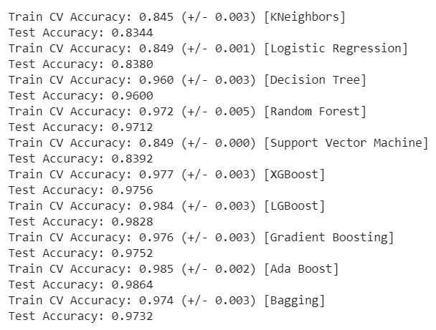
Second Task
prediction
The accuracies of different models.
The accuracy of Ada Boost and the LGBoost are the highest than other models.

Slide 10
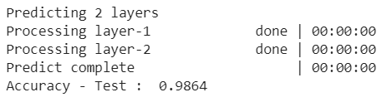
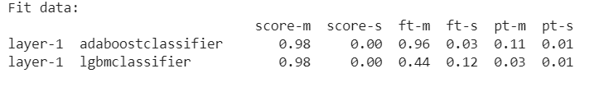
Second Task(contd.)
prediction
Ensemble Accuracy
The accuracy of ensemble model built using the two best performing models doesn’t change from the single model(Ada Boost).

